Slide 1
High-Level System Architecture
Sub Systems
High-Level Planner: Planning high-level behaviors, such as self-reconfiguration and self-assembly.
Coordinate System: Coordinate robots location and orientation.
Actuator: Transfer the primitives to actual robot action sequence.
Mediator: Relay the messages between robots and planner, enable the communication between different systems.
Coordinate System
High-Level Planners
Actuator
Mediator
Robots
https://github.com/chengjunyan1/MSRR-System

Slide 2
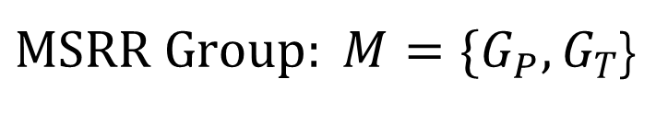
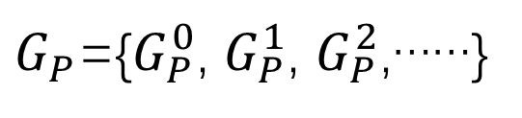
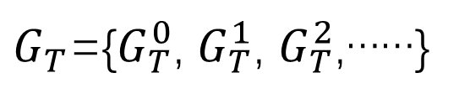
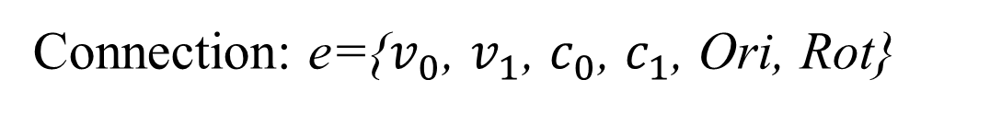


High-Level Planners
Primitives: Docking, Undocking
Self-Assembly Planner
Cycle detect and break
Find root and build tree
Assembly from inner layer to outmost

Slide 3
High-Level Planners
Self-Reconfiguration Planner
Cycle detect and break
Find common sub configurations
Search configurations centers
Evaluate cost of moving
Generate action sequence
Could reconfigure from arbitrary configurations to another, the number of configurations and modules could be different.
Considered the moving cost in planning.
Able to planning for multiple MSRR robots

Slide 4
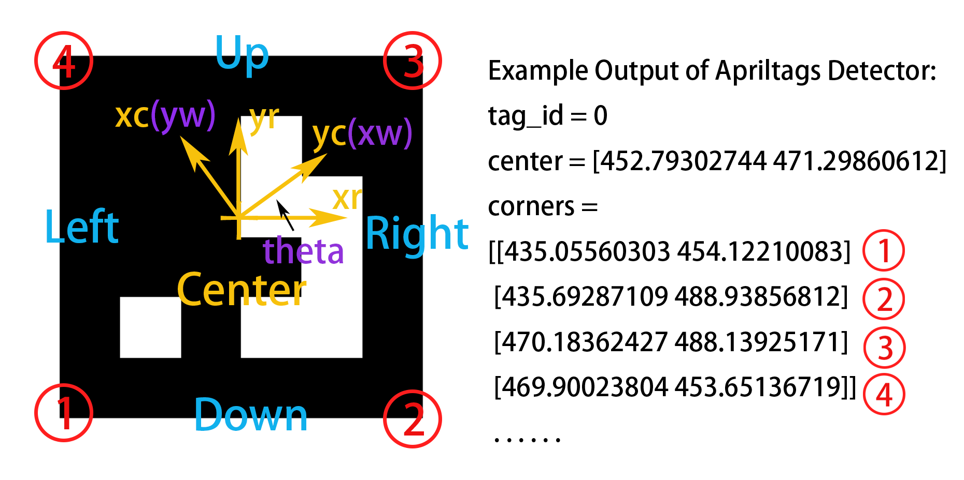
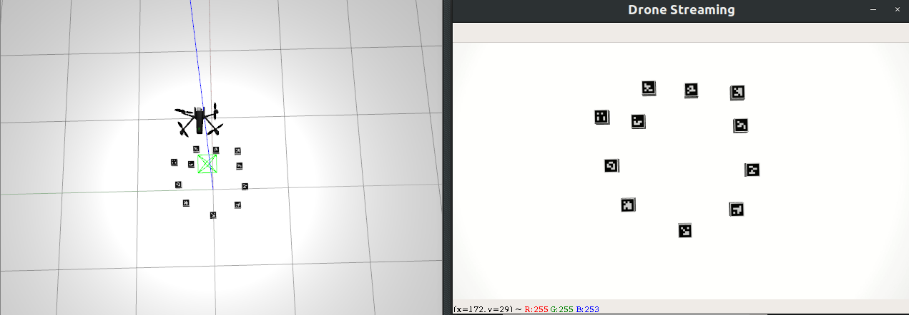
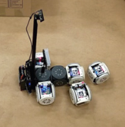
Coordinate System
Based on Apriltags 3
Coordinated by a Drone
Orthographic Projection
Reducing heterogeneity (compared to modlab’s)
Increase the horizons
More flexible

Slide 5
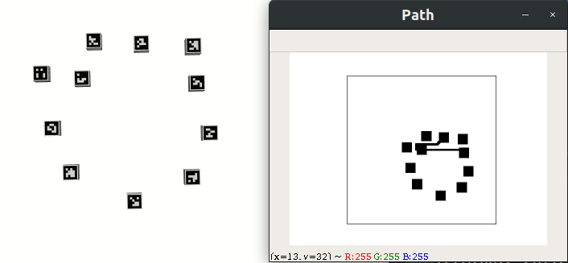
Actuator
Transfer Docking Primitive to path and desired orientation
Send [id x y theta xd yd thetad dxd dyd dthetad dt] to mediator every dt time
Moving multiple robots parallel
Planning and move all the robots in the same layer
Use multi threads send signal
Use sync semaphore to ensure a layer start after previous layer end
Use mutex to ensure different thread send message without interfere each other
JPS (Jump Point Search) Path Planner
Search-bases: A* return the shortest path, Theta* return smooth and shortest path, but both runs slow.
Sampling-based: RRT runs very fast, RRT* is about to produce optimum result but not stable and difficult to get optimum result.
JPS runs fast and produce near-optimum result.

Slide 6
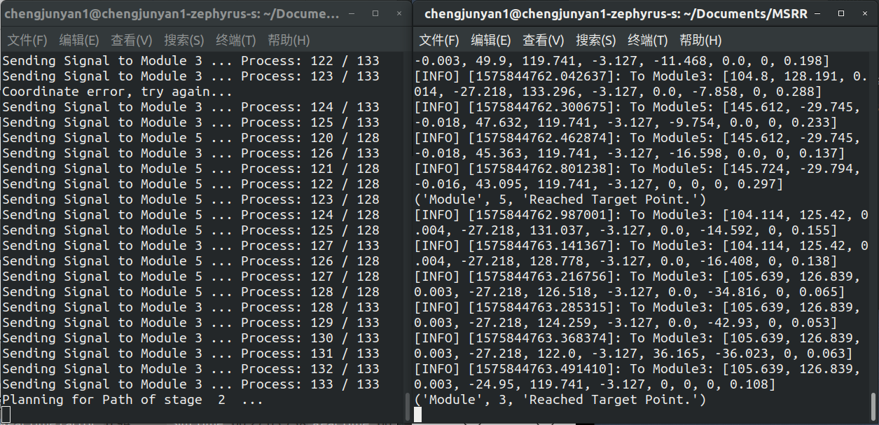
Mediator
Use socket to communicate with high-level planner
Communicate with low level by different ways
Solving the problem of communication between different platforms (e.g. our planner runs on python3 but ROS runs on python2)
Control and cooperation between multiple groups of robots
Make the extension of the system easier

Slide 7
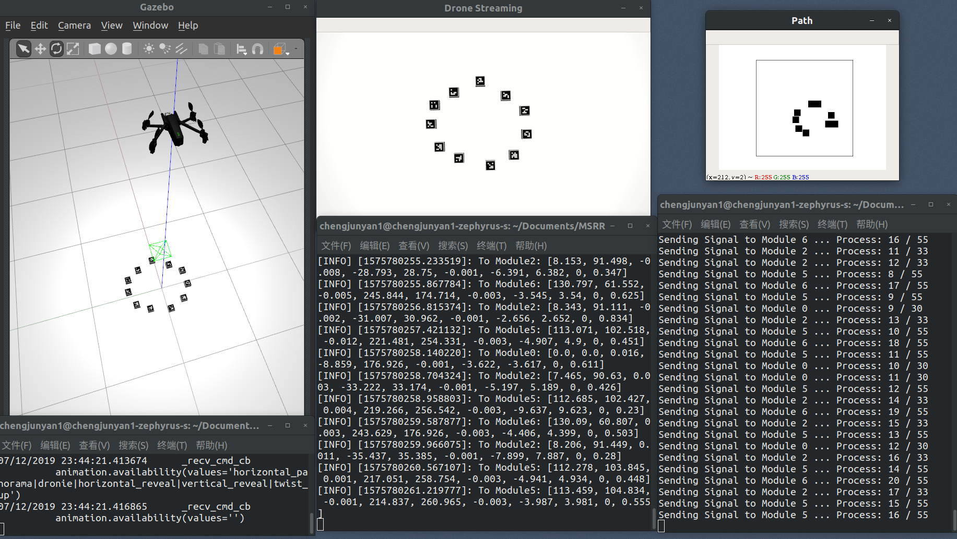
High-level planner system testing

